Slide 1
IS4432 Systems Design
Week 3 Systems Design
Adapted by Janet Yu
115/11/07
IS4432

Slide 2
Agenda
Verify & Validate the Analysis Models
Evolve the Models
  Factoring
  Partitions
  Layers
Packages & Package Diagrams
115/11/07
IS4432

Slide 3
Key Ideas
The purpose of the analysis phase is to figure out what the business needs (mainly about functional requirement).
The purpose of the design phase is to figure out how to provide it (and taking non-functional requirement into consideration)
The steps in both analysis and design phases are highly interrelated and may require much “going back and forth” - iterative
115/11/07
IS4432

Slide 4
Evolve Analysis Models into Design Models
Verify current analysis models and make sure they are consistent
Evolve the models
115/11/07
IS4432

Slide 5
Verification & Validation (V&V)
Through Walkthroughs
A walkthrough is a peer review of a product
  Presenter
  Recorder
  One who raises issues – the maintenance oracle
Everyone must be fully prepared
Try to omit management
115/11/07
IS4432
Notes:
- Walkthrough team should ask questions

Slide 6
For Functional Model
Use Case Diagram
Use Case
Description
Activity
Diagram
Eg sequential order of events in use case description should be the same as those in activity diagram
Eg relationships listed in use case description must be portrayed on the use case diagram
115/11/07
IS4432

Slide 7
For Structural Model
Classes, attributes and operations complete?
Relationships complete?
Association class necessary?
Subclasses necessary? Or just simply different states?
115/11/07
IS4432

Slide 8
Balancing the Different Models
The models should be consistent with each other. For example:
  Each and every class must be associated with at least one use case
  A sequence diagram must be associated with a use case on the use-case diagram
  Different states in a behavioral state machine must be associated with different values of an attribute or sets of attributes that describe an object
115/11/07
IS4432

Slide 9
Evolve the Models
Analysis activities defined the functional requirements
System design addresses both the functional and nonfunctional requirements
  Add system environment details
  Refine the problem domain
Incremental and iterative
115/11/07
IS4432

Slide 10
Evolve the Models
Factoring
Partitions
Layers
115/11/07
IS4432

Slide 11
Factoring
Separating out a module into a stand-alone module which can be a new class or a new method
Two processes
  Abstraction
    Creation of a higher level idea from a set of ideas
  Refinement
    Opposite of abstraction
115/11/07
IS4432

Slide 12
Abstraction
Generalization (a kind of)
  Classes with similar attributes and methods => super class
  Related classes with different attributes and methods => sub class
Aggregation (logical part of)
Composition (physical part of)
115/11/07
IS4432

Slide 13
Partitions
Creating “subsystems” or larger units
  Eg accounting system = accounts payable system + account receivable system + payroll system + … + …
Complicated models can overload both the user and developer
Group elements (that collaborate with each other) together
  ➔ simplified models lead to easy understanding
  ➔ allocation of work
115/11/07
IS4432

Slide 14
How ?
Look at the collaboration modeled in the communication diagrams
More messages sent, more likely they belong in the same partition
Can also look at the CRUD matrix
115/11/07
IS4432

Slide 15
Layers
Start considering non-functional requirement in the system environment such as
  Data management
  User interface
  Physical architecture
115/11/07
IS4432

Slide 16
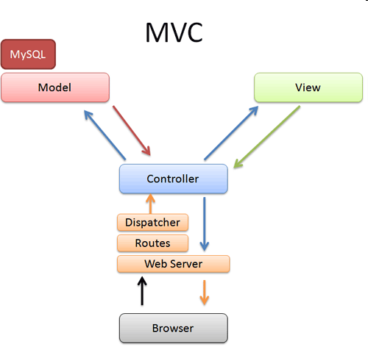
Early Appearance of Layers – in Smalltalk
Model-view-controller (MVC) architecture
  Models implement application logic
  Views handle output and user interface
  Controllers control input and user interfaces
Separating application logic from user interface logic
115/11/07
IS4432
http://betterexplained.com/wp-content/uploads/rails/mvc-rails.png

Slide 17
Different Software Layers
Foundation
  Fundamental data types – integers, characters
  Container classes – lists, sets, queues
  Utility classes – date, time
Problem domain
Data management
  Deal with how objects are stored and retrieved
Human-computer interface (HCI)
  Classes associated with the view and controller
  For portability
Physical architecture
  Classes that communicate with the OS and the network
115/11/07
IS4432

Slide 18
Packages
Logical grouping of UML elements
Simplifies UML diagrams
  Groups related elements into a single higher-level element
  Eg group use cases together to make the use case diagram easier to read and to keep the model at a reasonable level of complexity
  Eg group classes together
Dependency relationships
  Shows a dependency between packages
Provide structure and less complex views of the new system
115/11/07
IS4432

Slide 19
Steps for Building Package Diagrams
Set the context
Cluster classes together based on shared relationships
Model clustered classes as a package
Identify dependency relationships among packages
Place dependency relationships between packages
115/11/07
IS4432

Slide 20
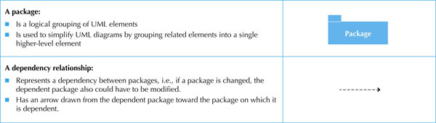
Package Diagram
Package A
Package B
Package A is dependent on Package B
ie changes in B potentially causes a change in A
115/11/07
IS4432

Slide 21
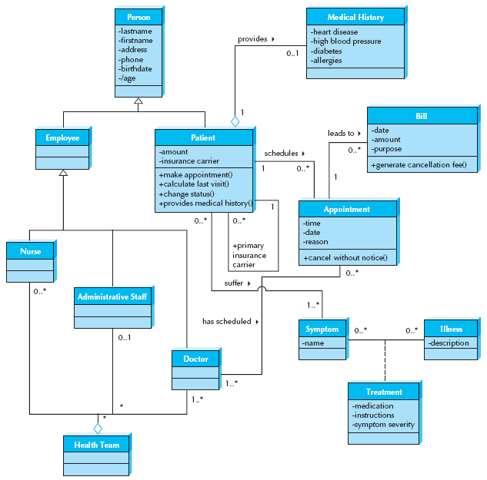
Class Diagram for the Appointment
System
115/11/07
IS4432

Slide 22
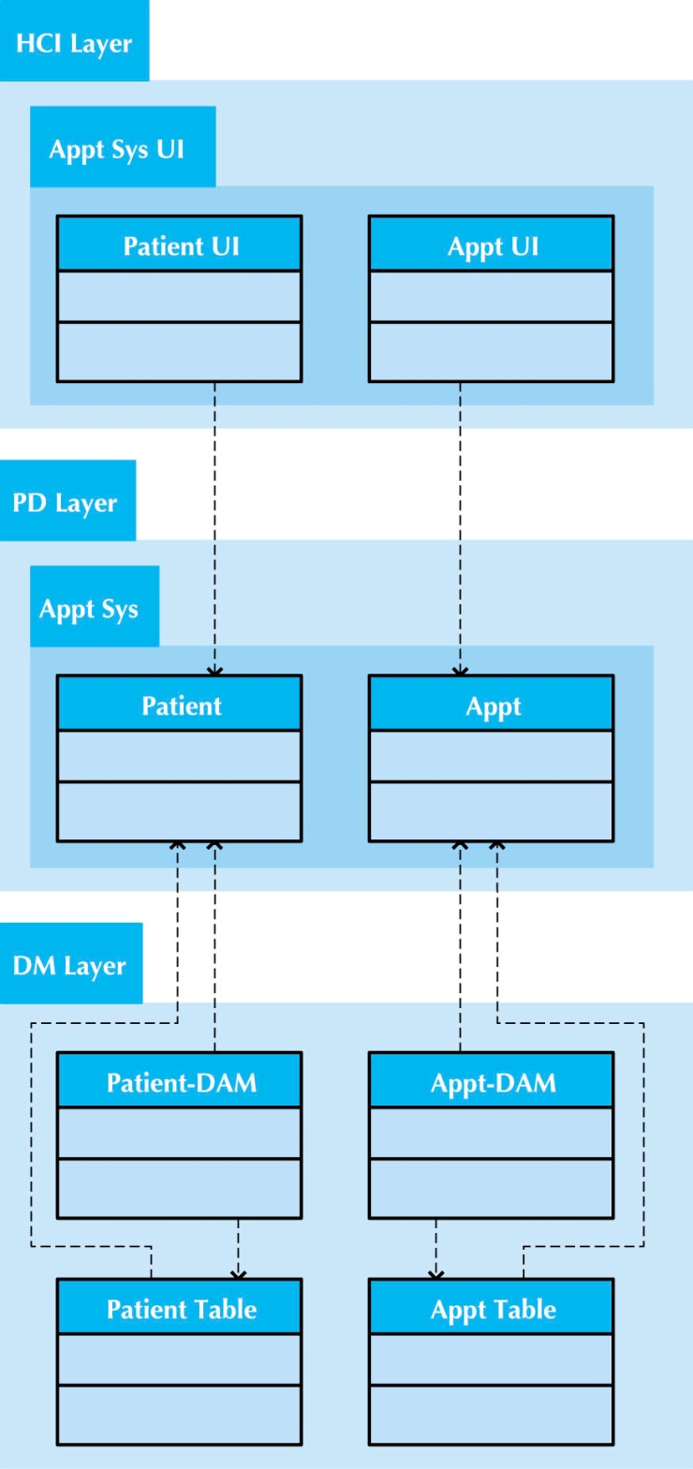
Partial Package for the Appointment System
115/11/07
IS4432

Slide 23
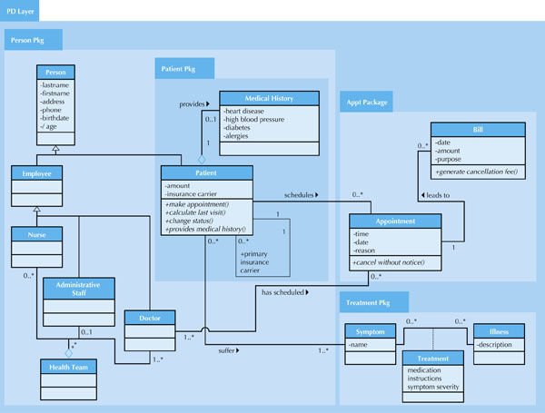
Package Diagram for the
Appointment
System
115/11/07
IS4432

Slide 24
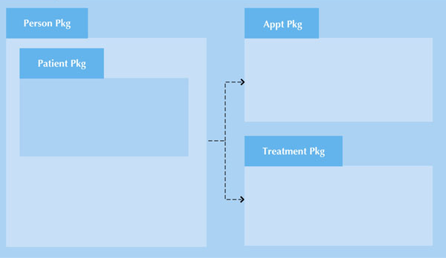
PD Layer for the Appointment System
115/11/07
IS4432

Slide 25
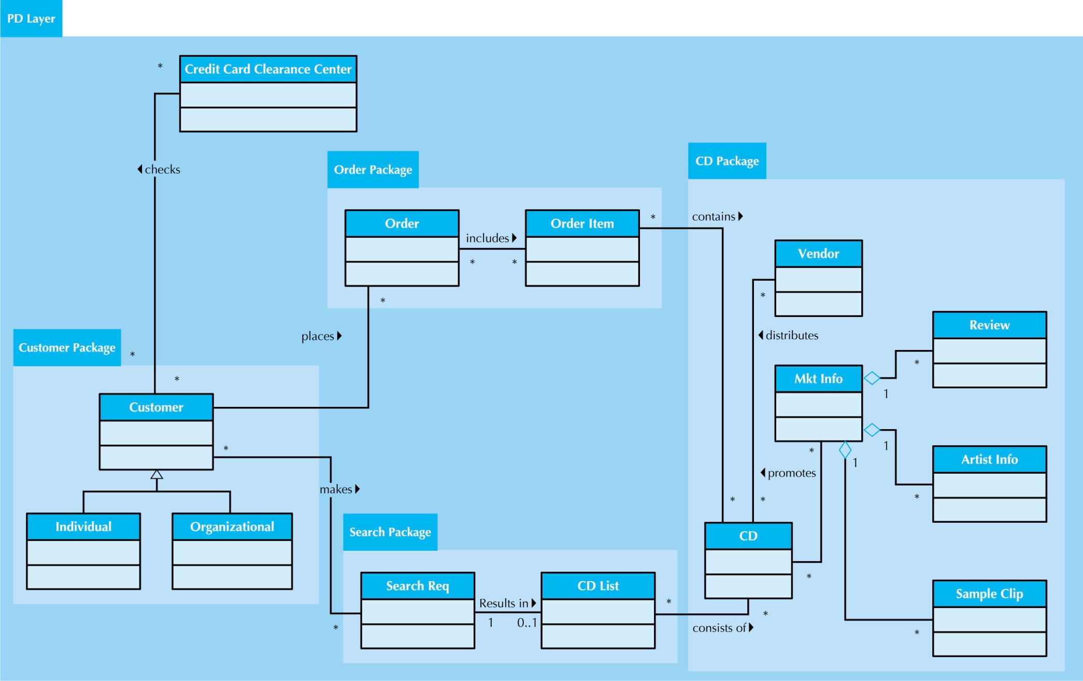
Package Diagram for the
CD Selections Internet Sales System
115/11/07
IS4432

Slide 26
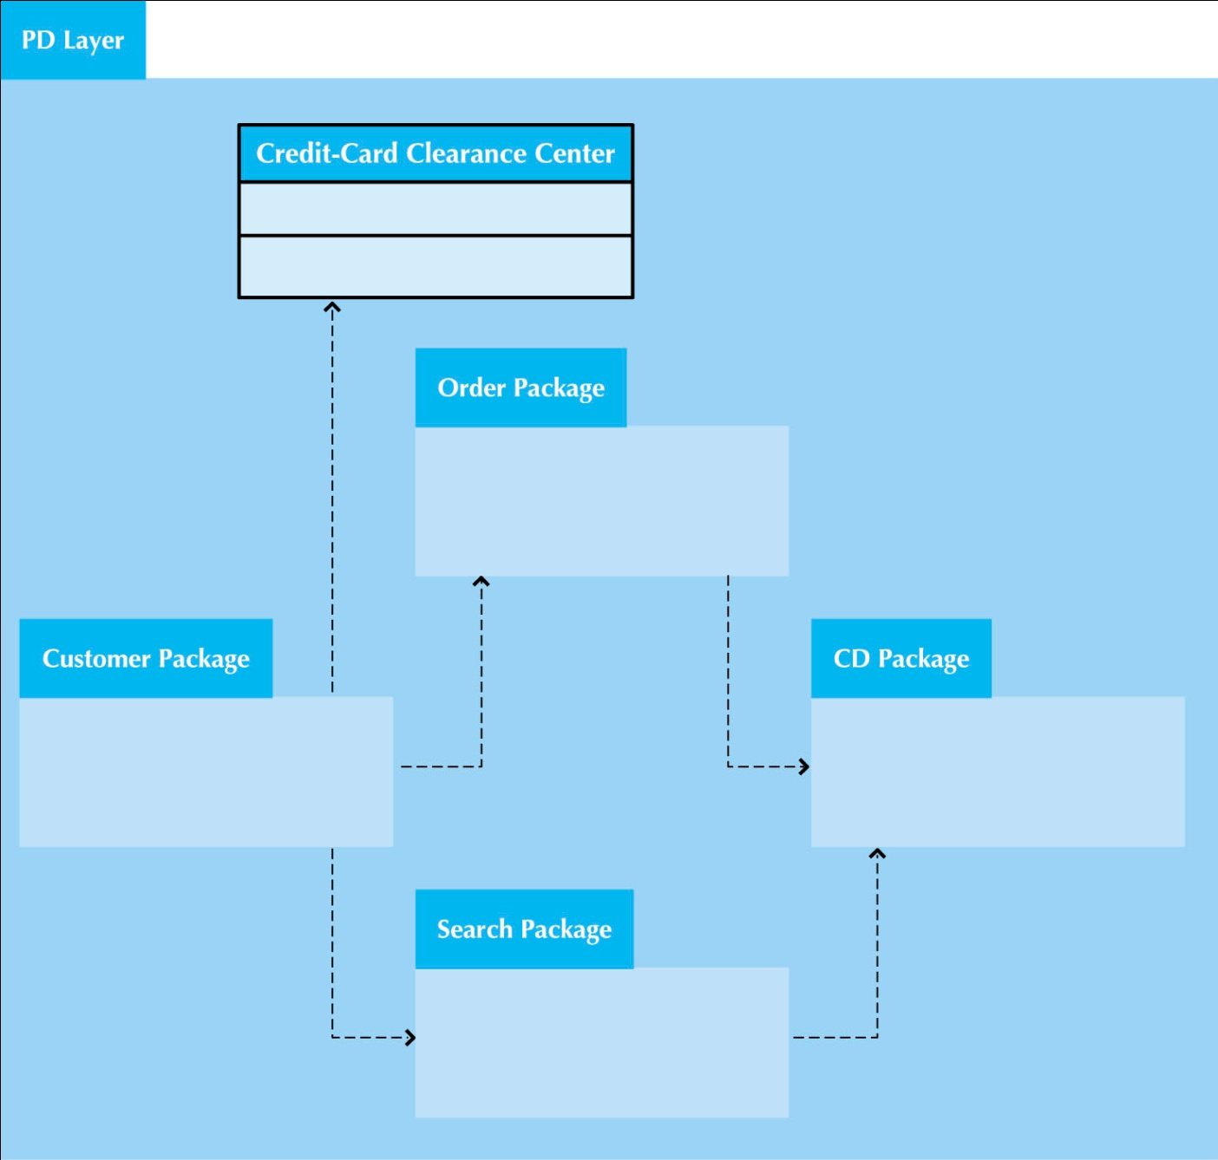
PD Layer of the
CD Selections Internet Sales System
115/11/07
IS4432

Slide 27
Components of System Design
Evolve analysis models into design models
Design strategies – build from scratch, purchased and customized, or outsourced to others
Class and Method design
Database design
Design user interface, system inputs and outputs
Physical architecture – how to organize hardware and software
115/11/07
IS4432

